Slide 1
Final Project
Richa Patel
Python for Everybody

Slide 2
Rhode Island Police and local Weather data

Slide 3
Summary
Rhode Island Police data are a very important and distinct segment of the Research analysis.
They are varying in sizes, and general structure.
This police data uses a collection of state, stop date, stop time, county name, driver gender, driver race, violation raw, violation, search conducted, search type, stop outcome, is arrested, stop duration, drugs_related_stop, district.

Slide 4
Introduction
To utilize the Rhode Island police data set to analyzing the effect of weather on policing and Topmost reason for violation and Comparing violations by gender and Comparing stop outcomes by gender.
91,741 records from Rhode Island Police Department’s traffic stops between January 4th, 2005 and December 31st, 2015.
The analysis assumed that all the data is gathered with the same method and naming is consistent.

Slide 5
Read data into Data Frame and separated records based on gender, and then used to create visuals to better analyze the data. Reviewed data in .csv file, used Python to import into Data Frame, and worked with Data Frame to answer questions.
After error handling, no notable errors were encountered
The conclusion I reached was that Topmost reason for violation is Speeding and least reason is Seat Belt. Citation has high value. and There's no bias here for pulling over non-white driver’s vs white drivers but other race is less stopped by. Male is stopped than Female.

Slide 6
Data characteristics
In order to get a data, read file for police and weather CSV. we can see that we have 91741 rows and 15 columns for police and [ 4017 rows x 27 columns] for weather. Topmost reason for violation is Speeding and least reason is Seat Belt. Citation has high value. and There's no bias here for pulling over non-white driver’s vs white drivers but other race is less stopped by. Male is stopped than Female.

Slide 7
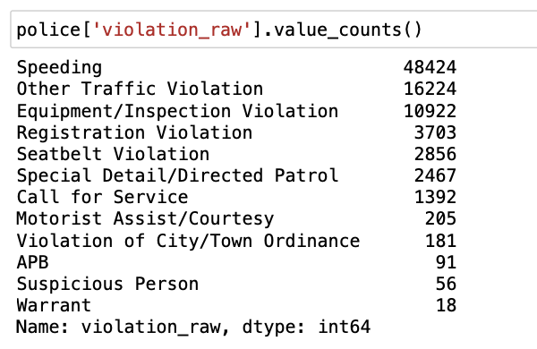

Slide 8
Examining traffic violations
We can see Speeding has number 48424 and Warrant 18
Topmost reason for violation is Speeding and least reason is warrant
Other Traffic Violation 16224
Suspicious Person 56

Slide 9
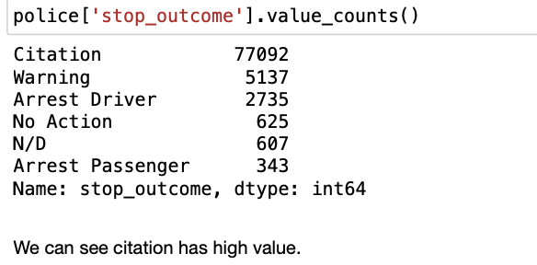

Slide 10
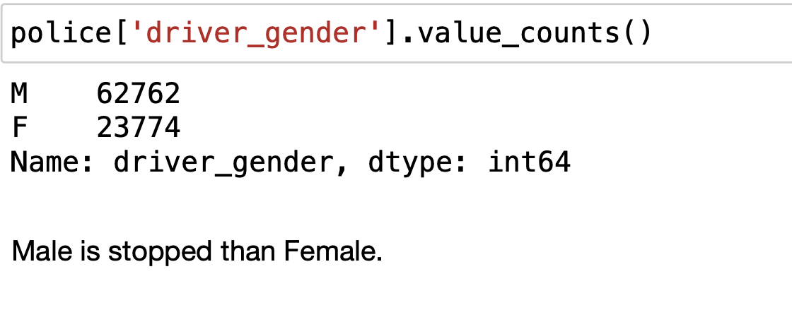
Comparing violations by gender
We can see Male is more stopped than female

Slide 11
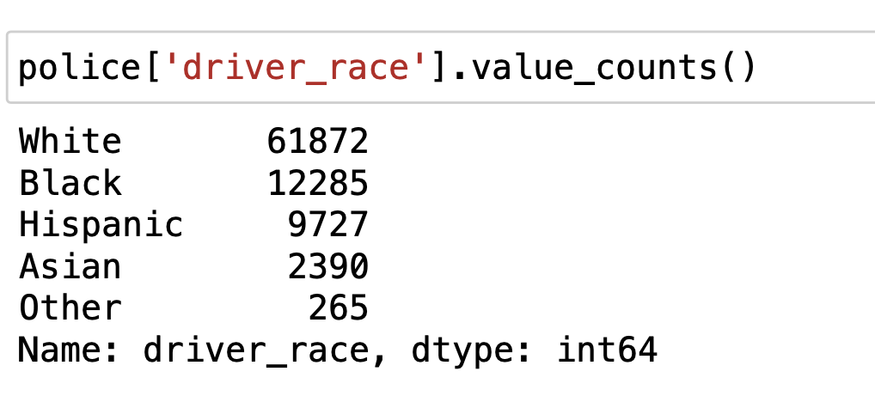
Comparing violations by Race
There's no bias here for pulling over non-white driver's vs white drivers but other race is less stopped by.

Slide 12
Weather and Police
We can see TMIN TAVG and TMAX.
Create a 'TDIFF' column that represents temperature difference weather ['TDIFF'] = weather.TMAX - weather.TMIN
Describe the 'TDIFF' column using print method
Create a histogram with 20 bins to visualize 'TDIFF’ weather.TDIFF.plot(kind = 'hist', bins = 25)
Create a box plot of the temperature columns
weather[['TDIFF']].plot(kind = 'box')
Display the plot using show method

Slide 13
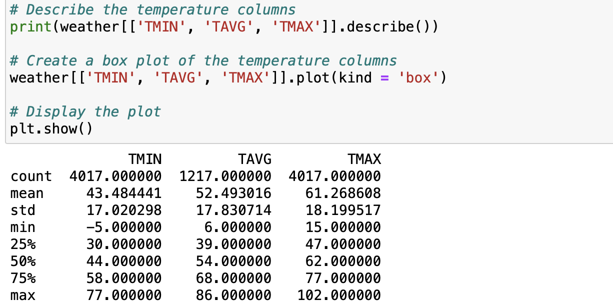

Slide 14
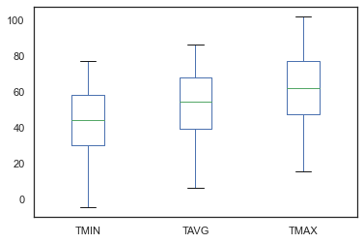

Slide 15
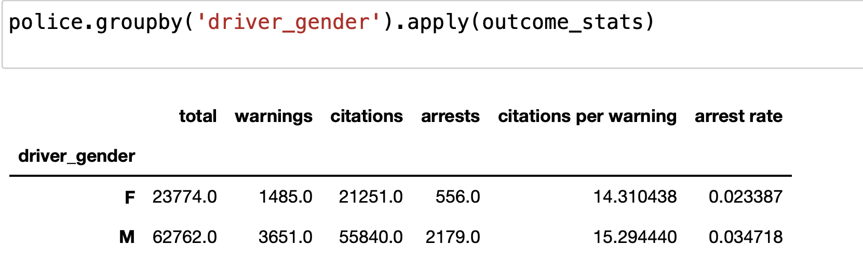
Comparing outcome stats with gender

Slide 16
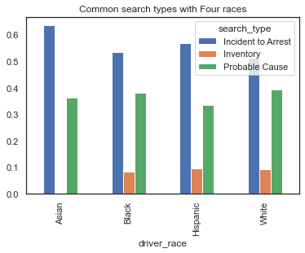
Common search types with Four races

Slide 17
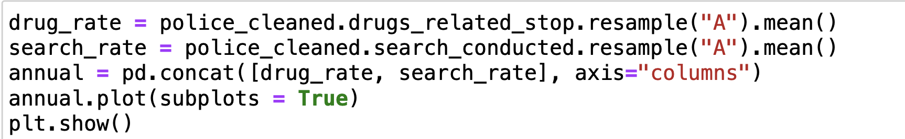
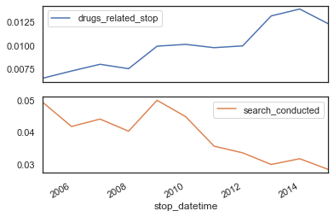
Search conducted

Slide 18
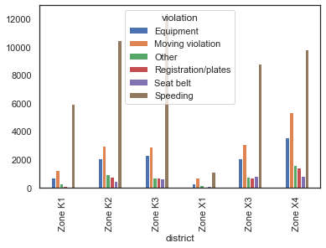
Distribution all the violation

Slide 19
Summary
I came into this blind, but I assumed that both Genders would have roughly the same chance at getting cited.
Across the sample data, the most-common types of traffic violation were speeding violations, moving violations, and equipment violations. we found that males are the drivers in about 72.5270% of the sampled traffic stops; and that the Rhode Island Police Department Districts ranked by total sample traffic stops are the “Zone X4” district, the “Zone K3” district, the “Zone K2” district, the “Zone X3” district, the “Zone K1” district, and the “Zone X1” district.

Slide 20
Thank you

